Slide 1
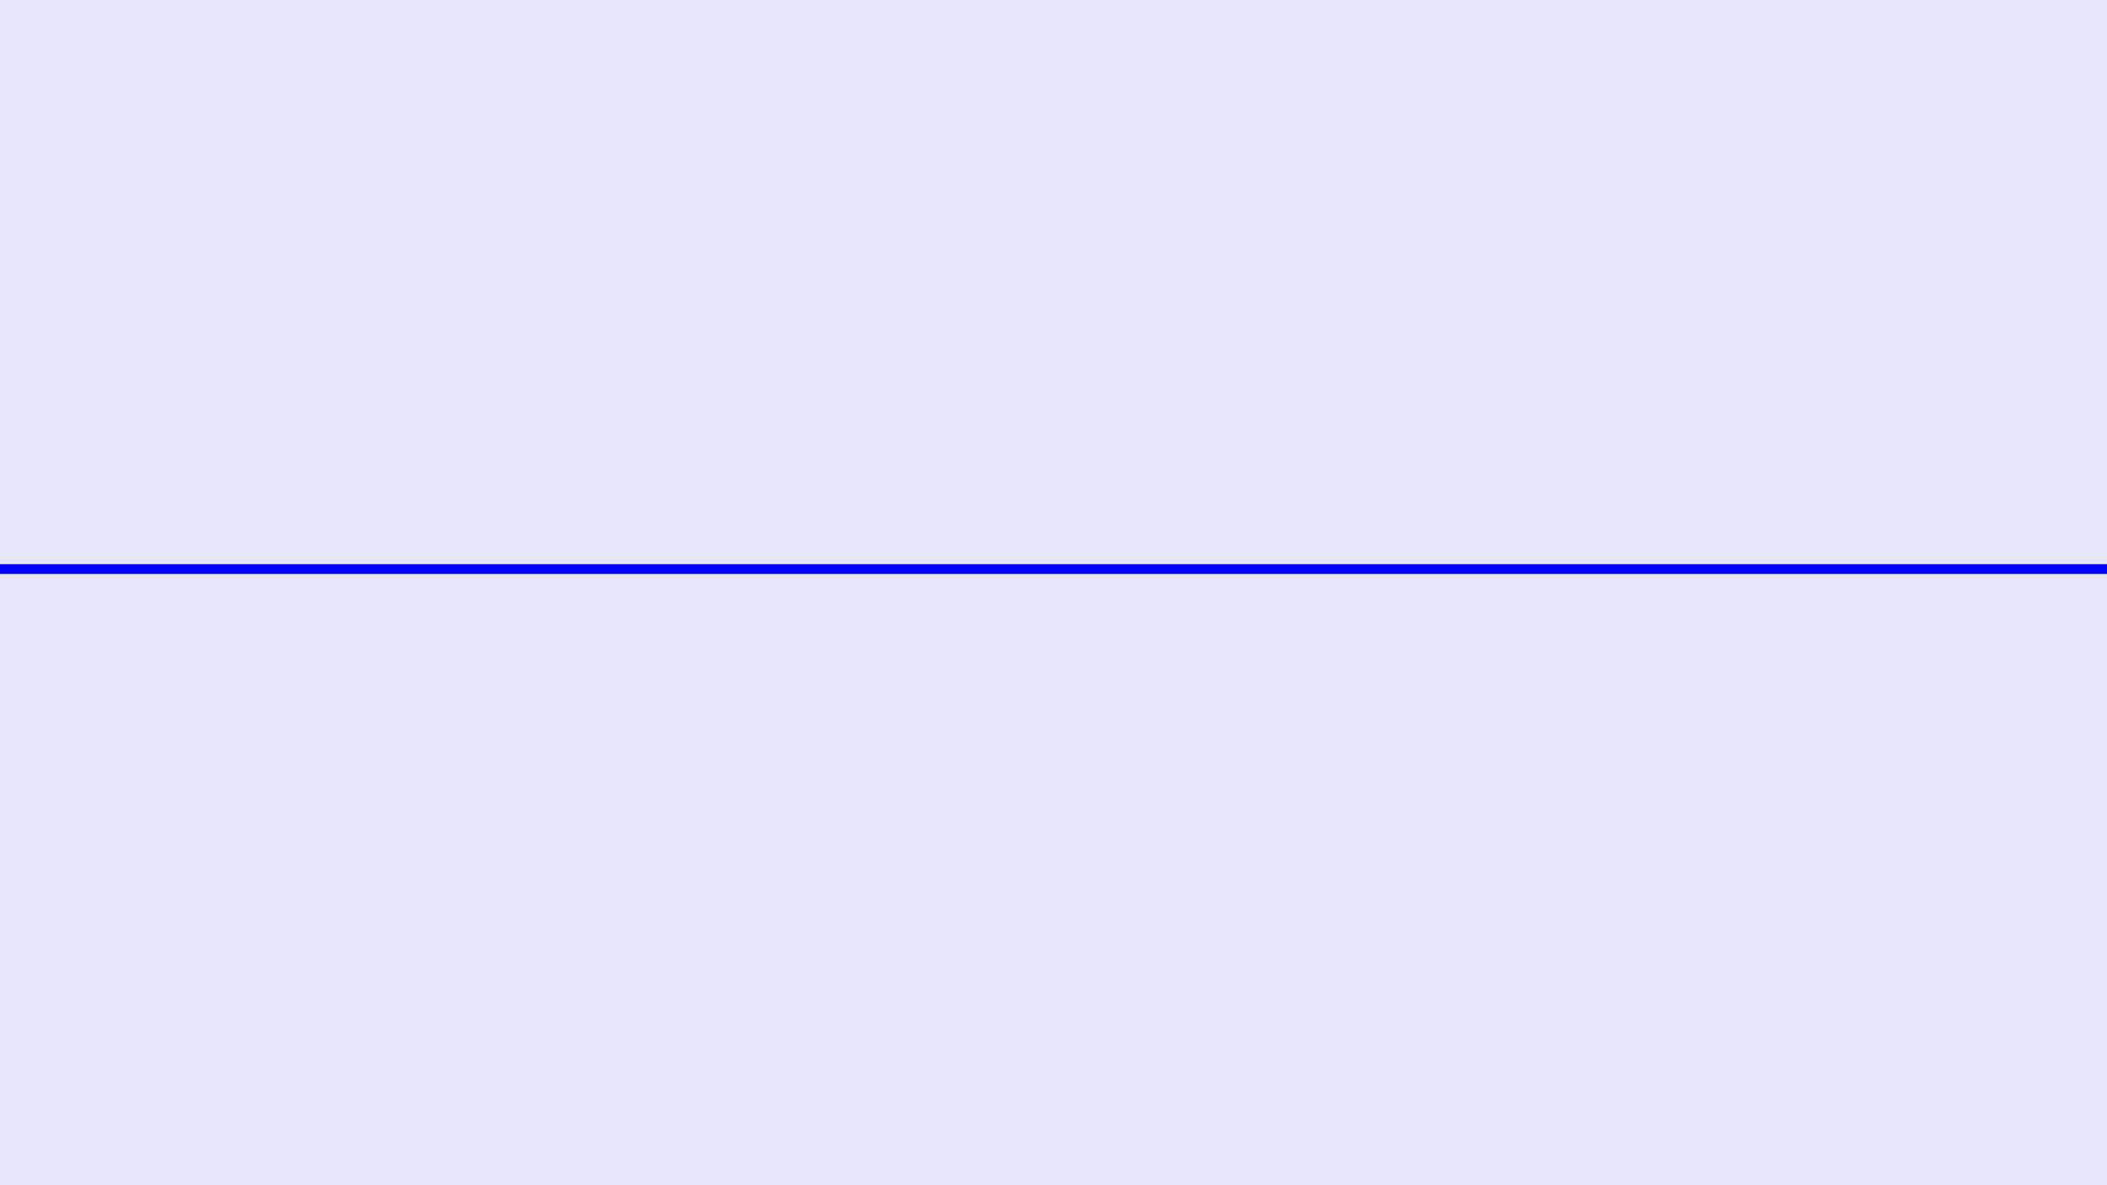
WRINDHA OS
COMPREHENSIVE MARKETING STRATEGY 2026: SOCIAL MEDIA LANDSCAPE, AUDIENCE INSIGHTS, AND GROWTH ROADMAP

Slide 2
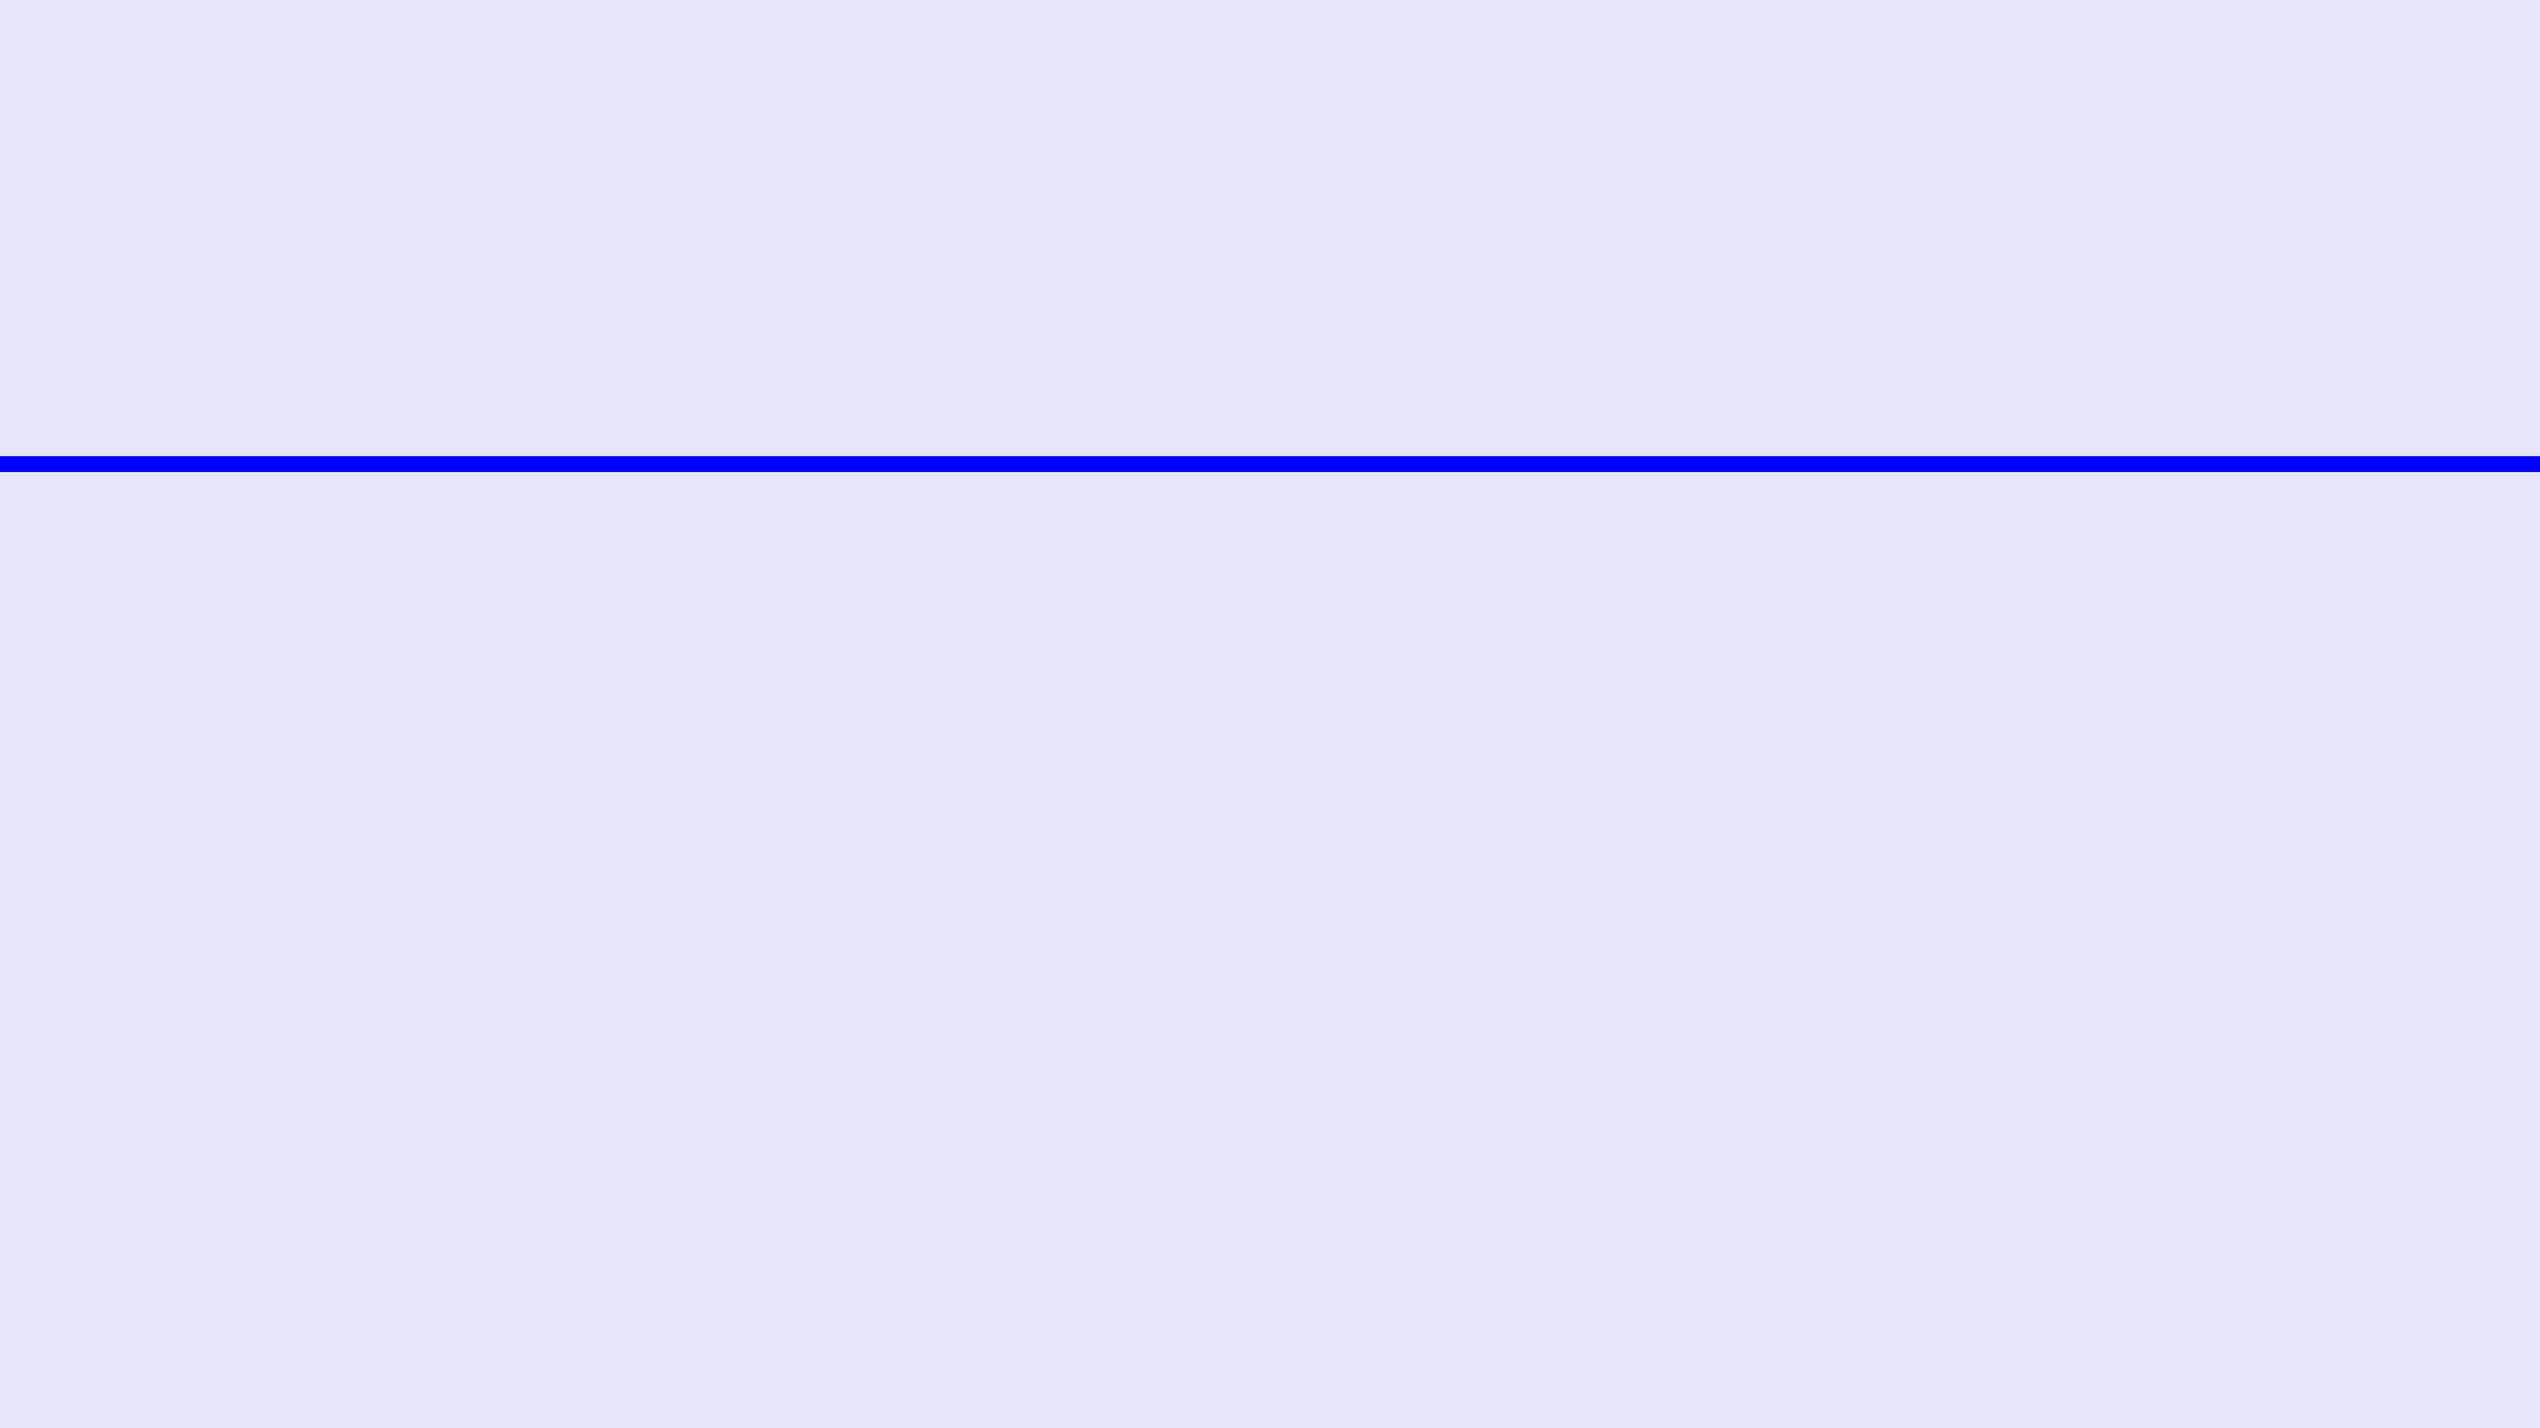
EXECUTIVE SUMMARY
KEY INSIGHTS
RECOMMENDATIONS
The 2026 social media landscape is defined by a massive surge in active users, reaching 5.66 billion globally. In India, Instagram are witnessing unprecedented growth, making them primary channels for product discovery and engagement. Short-form video content now accounts for over 58% of total time spent on social media, signaling a fundamental shift in user consumption patterns.
Wrindha OS must adopt a video-first content strategy, prioritizing Reels and YouTube Shorts to capture attention. Content should focus on demonstrating capabilities and study systems through bite-sized, actionable tutorials. Adapting to platform-specific algorithms is no longer optional; it is the cornerstone of organic reach in 2026.
Users are increasingly moving away from traditional search engines like Google, preferring the visual and community-driven discovery offered by TikTok and Instagram. This trend is particularly pronounced among Gen Z and students, who prioritize authenticity and peer recommendations over polished corporate messaging.
Implementation of a structured 90-day roadmap is essential to build brand authority. This includes monthly themes focused on awareness, engagement, and retention. By leveraging social search optimization and community-led growth, Wrindha OS can establish itself as the leading personal operating system for the Indian market.

Slide 3
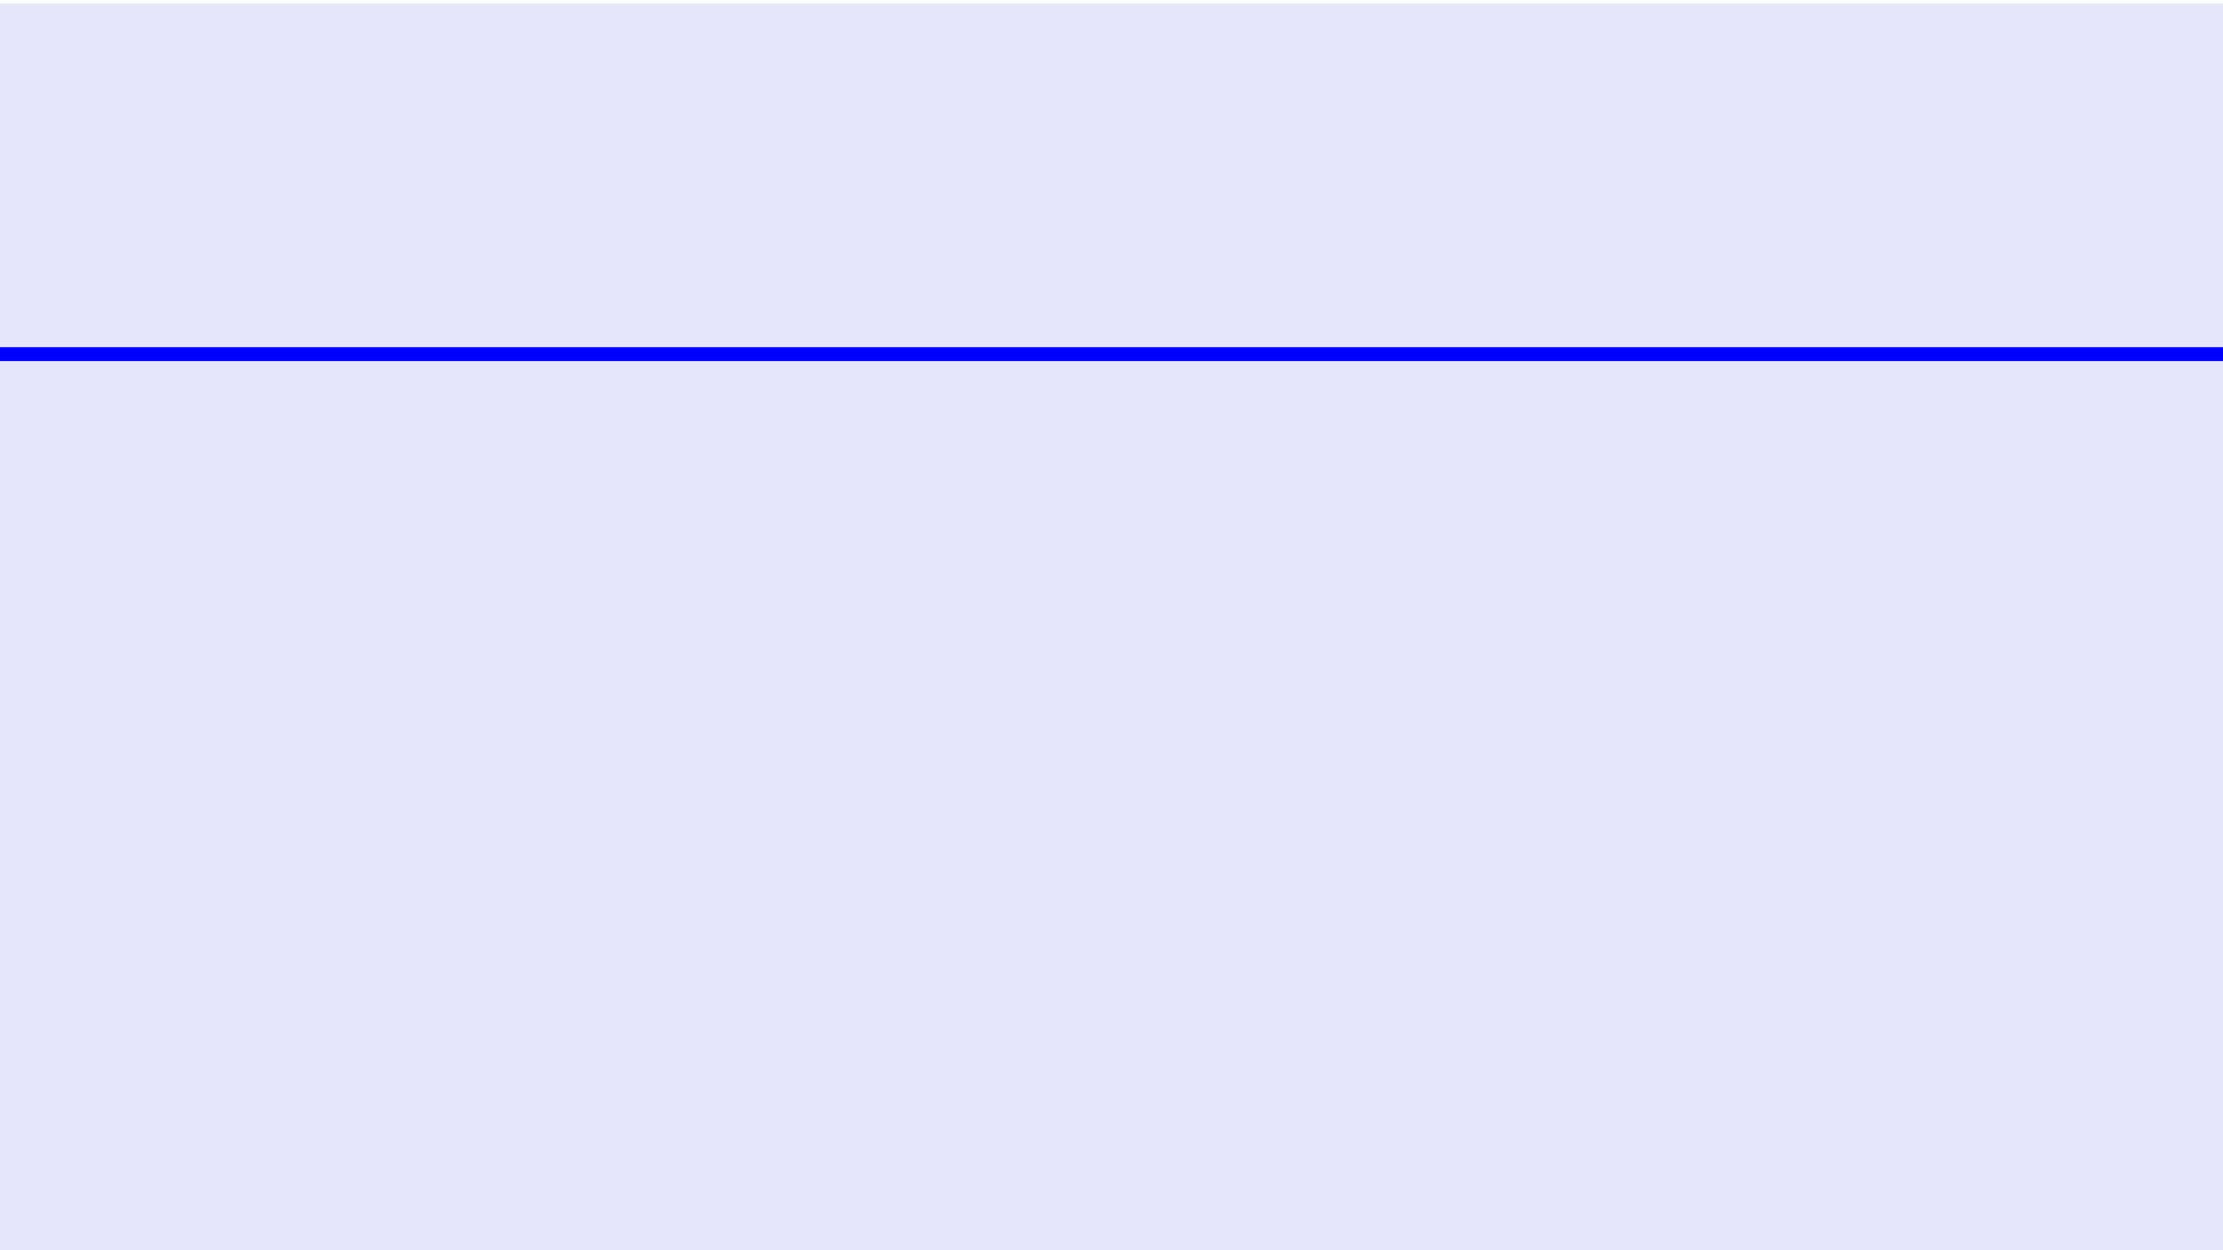
MARKET OPPORTUNITY
WRINDHA OS OVERVIEW
PRIMARY AUDIENCES
Wrindha OS is an all-in-one personal operating system designed to unify fragmented digital lives. It integrates study planning, productivity tools, habit building, and goal management into a single cohesive environment. By providing a structured system for life organization and personal growth, Wrindha OS addresses the increasing complexity of managing career development and daily routines in a digital-first world.
Our core market consists of high-intent segments: students and competitive exam aspirants in India, college students, and lifelong learners. We also target working professionals seeking efficiency and self-improvement enthusiasts who prioritize habit-building and goal-setting. These groups are actively searching for technology that can streamline their learning systems and enhance their daily productivity through organized life management.

Slide 4
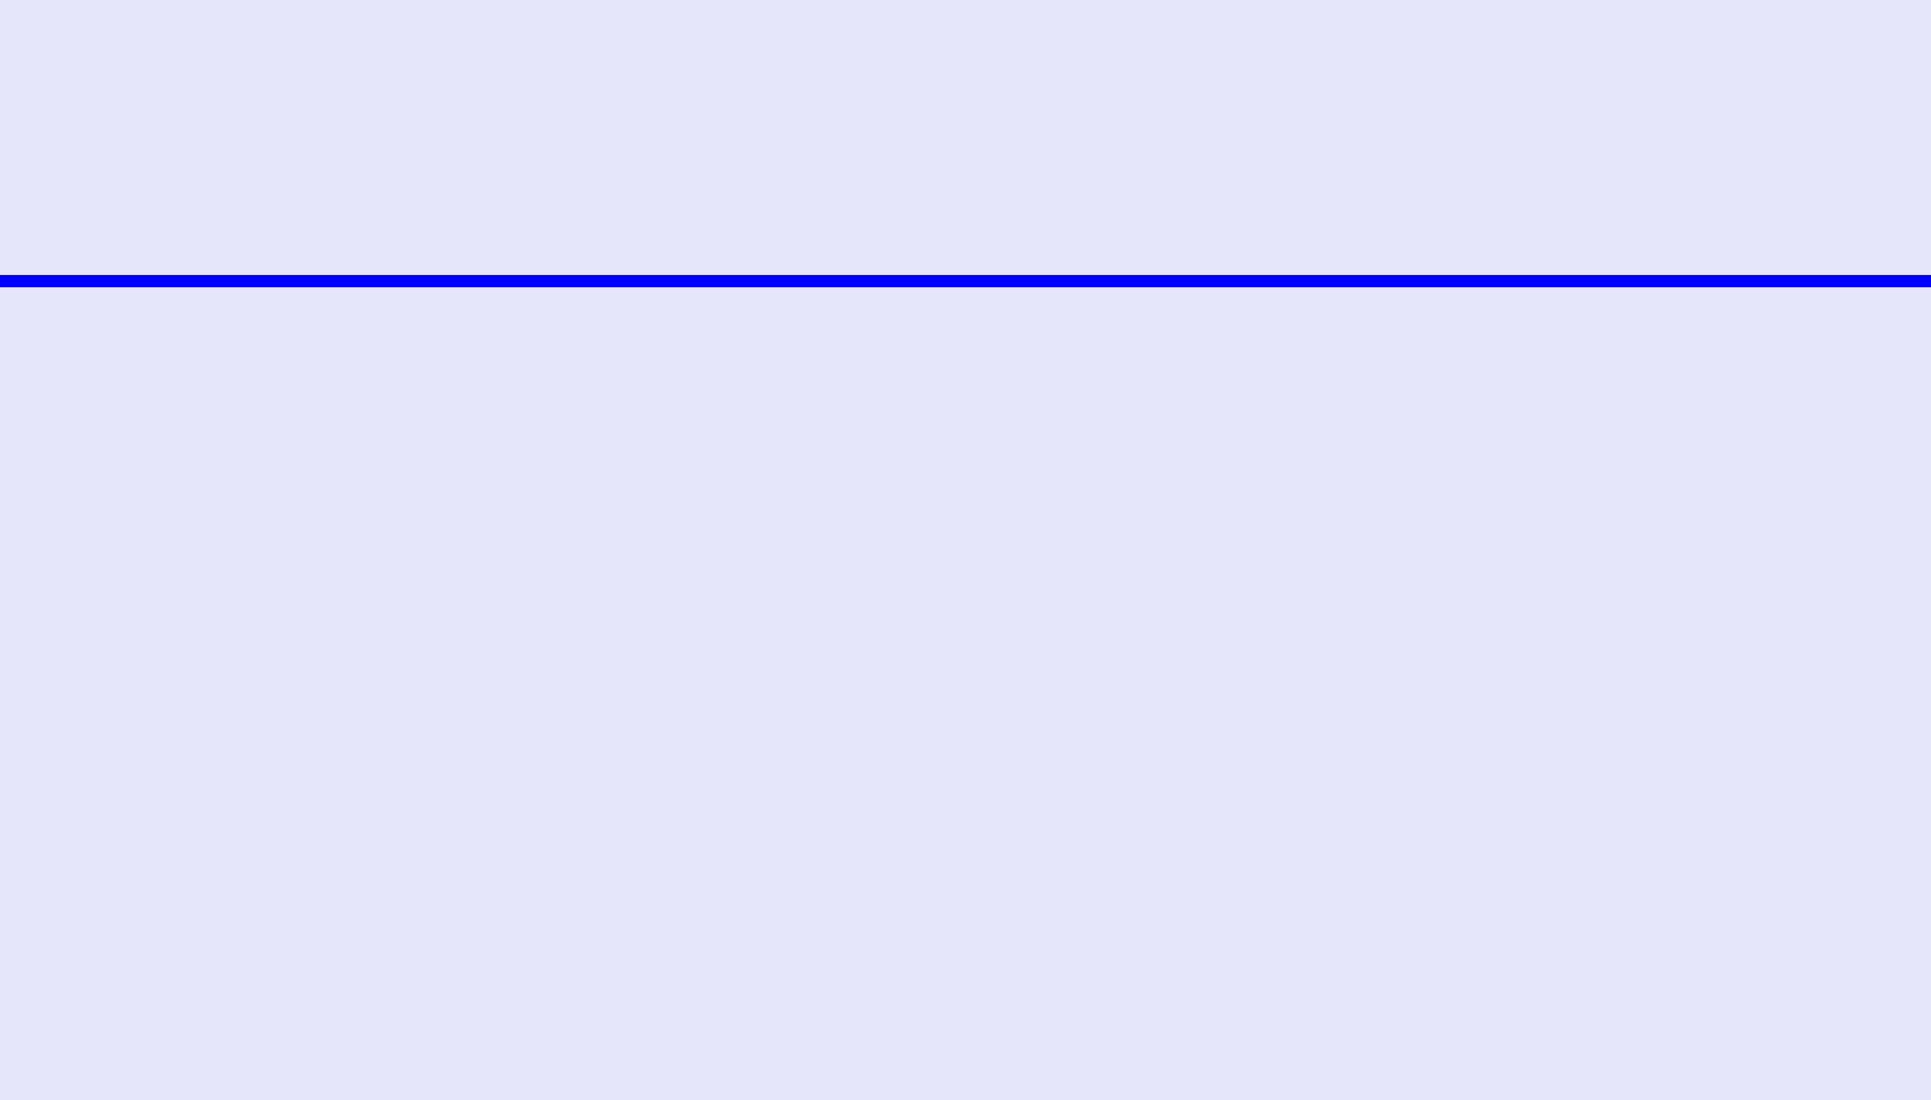
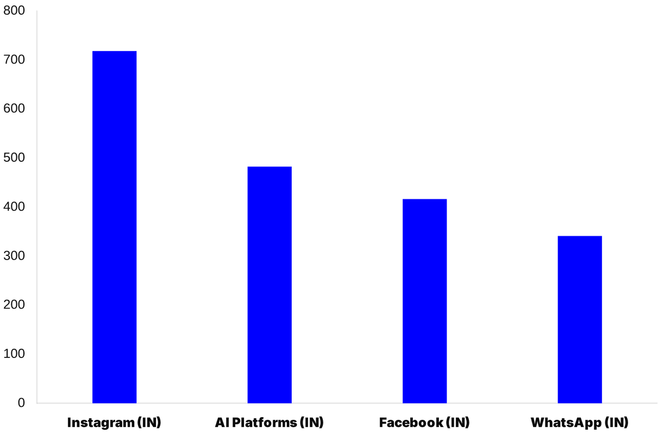
SOCIAL MEDIA LANDSCAPE 2026
GLOBAL REACH & BEHAVIOR
By mid-2026, global social media user identities have reached 5.66 billion, representing 68.7% of the world's population. The defining characteristic of this era is the dominance of short-form video, which now commands 58% of all time spent on social platforms. This shift has fundamentally altered how information is consumed and how brands must communicate.
THE INDIAN ENGINE
India has emerged as the primary demand engine for global social platforms. Instagram leads with over 717 million users, while AI-driven platforms have seen a meteoric rise to 481 million users. For Wrindha OS, this represents a massive opportunity to grow in productivity directly into the daily digital habits of the world's largest connected youth population.

Slide 5
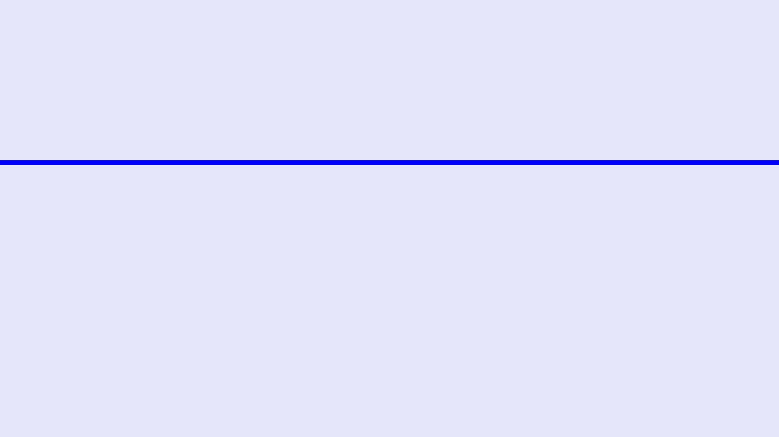
AUDIENCE PERSONAS
ASPIRANTS & STUDENTS
WORKING PROFESSIONALS
PASSIONATE LEARNERS
This segment represents the core user base in India, primarily aged 16-24. They are driven by high-stakes competitive exams and academic excellence. Their digital behavior is characterized by intensive search for study techniques, focus-enhancing tools, and motivational content. They seek a unified system that can manage their rigorous schedules
Aged 25-45, these users are focused on career advancement and operational efficiency. They face challenges like burnout and information overload in fast-paced corporate environment. They value Wrindha OS for its ability to integrate professional goal tracking with personal life organization. Their interest lies in AI tools that can automate mundane tasks and frameworks that support deep work and long-term career growth.
Self-improvement enthusiasts aged 20-50 who prioritize holistic growth and habit formation. They are early adopters of technology and are often found engaging with communities centered around productivity and mindfulness. For them, Wrindha OS is a "Second Brain" that helps maintain consistency in their daily routines, tracks their diverse learning goals, and organizes their personal knowledge base efficiently.

Slide 6
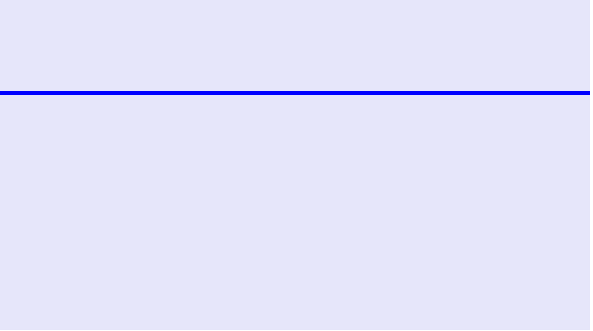
ASPIRANTS & STUDENTS
DEMOGRAPHICS & PLATFORMS
PAIN POINTS & MOTIVATIONS
CONTENT INTERESTS
The primary segment consists of Indian students aged 16-24, including competitive exam aspirants (JEE, NEET, UPSC). Their digital life is centered around YouTube for educational content, Instagram for motivation and lifestyle, and WhatsApp for peer-to-peer study groups. This demographic is highly mobile-first and spends an average of 2 hours and 40 minutes daily on social platforms, seeking both academic resources and community support.
Students face significant challenges including exam-related stress, lack of focus, and information overload from fragmented resources. Their primary motivation is academic success and career security, but they struggle with consistent habit formation and time management. Wrindha OS addresses these by providing a unified system that reduces cognitive load
This audience actively searches for evidence-based study techniques such as Active Recall, Spaced Repetition, and the Feynman Technique. They are increasingly interested in how AI tools can assist in learning and organization. Content that provides actionable productivity hacks, "Study with Me" sessions, and transparent founder insights into the building of educational tools resonates deeply, driving high engagement and brand loyalty.

Slide 7
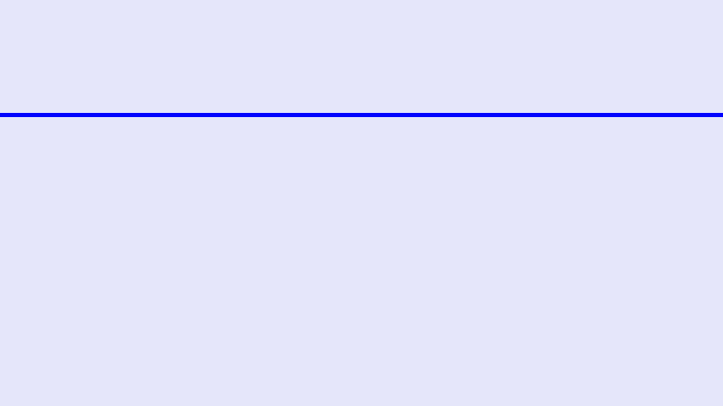
WORKING PROFESSIONALS: CAREER & PRODUCTIVITY
DEMOGRAPHICS & PLATFORMS
PAIN POINTS & MOTIVATIONS
CONTENT INTERESTS
This segment comprises individuals aged 25-45, ranging from early-career professionals to mid-level managers. They are primarily active on LinkedIn for professional networking and industry news, YouTube for skill-building tutorials, and X for real-time industry discussions. Their digital behavior is characterized by a search for efficiency and high-value content that can be consumed during commutes or short breaks.
Working professionals face significant challenges in maintaining work-life balance and avoiding burnout. They struggle with productivity bottlenecks and the pressure to adapt to rapidly evolving technologies like AI. Their primary motivations include career advancement, professional development, and staying competitive in a global market. They seek systems that offer clarity and reduce the cognitive load of daily task management.
Interest is heavily skewed towards AI tools for work automation and time management frameworks such as Deep Work and the Pomodoro Technique. They value leadership insights, digital well-being strategies, and life organization systems like the "Second Brain." Content that offers actionable advice on career pivoting, skill enhancement, and leveraging technology for professional growth resonates most strongly with this audience.

Slide 8

PASSIONATE LEARNERS
DEMOGRAPHICS & PLATFORMS
PAIN POINTS & MOTIVATIONS
CONTENT INTERESTS
This segment comprises individuals aged 20-50 who are driven by continuous personal growth and mastery. They are early adopters of technology and active participants in digital communities. Their primary platforms include Instagram for inspirational content and habit tracking, YouTube for educational long-form deep dives, and specialized newsletters or blogs for niche expertise.
The primary challenge for passionate learners is maintaining consistency in habit building and finding reliable, evidence-based information amidst digital noise. They are motivated by personal mastery, skill acquisition, and holistic well-being. They seek systems that provide clarity and reduce the friction between setting a goal and achieving it, often struggling with goal tracking and motivation maintenance.
Passionate learners are highly interested in habit formation frameworks, goal-setting methodologies, and life organization systems like the "Second Brain." They consume content related to mindfulness, technology for personal growth, and digital minimalism. They prefer formats that offer actionable insights, such as detailed guides, habit-tracking templates, and case studies of successful personal transformations.

Slide 9

INSTAGRAM STRATEGY
REELS STRATEGY
CAROUSEL STRATEGY
STORIES & ENGAGEMENT
Reels are the primary engine for organic reach in 2026. Wrindha OS will deploy 3-5 Reels per week focusing on high-impact productivity hacks, study system demos, feature highlights. By leveraging trending audio and interactive elements like polls, we aim to capture the attention of the 717 million Indian users who prioritize short-form video for discovery and learning.
Carousels serve as deep-dive educational assets, perfect for step-by-step guides on study methods like Active Recall or Spaced Repetition. We will post 2-3 Carousels weekly, utilizing high-density infographics and success stories. This format is designed to drive saves and shares, positioning Wrindha OS as a reliable source of structured knowledge and life organization systems.
Stories will be used for daily community touchpoints, featuring behind-the-scenes content, quick tips, and interactive Q&A sessions. Our engagement strategy involves prompt responses to DMs and comments, fostering a loyal user base. Collaborations with micro-influencers in the productivity niche will further amplify our message and drive user-generated content campaigns.

Slide 10

YOUTUBE STRATEGY
SHORTS STRATEGY
LONG-FORM STRATEGY
SEARCH & SEO
Publish 4–5 Shorts weekly with quick productivity tips, feature highlights, and motivational snippets to drive top-of-funnel awareness and funnel viewers to long-form content.
Produce 1–2 long-form videos per week: deep tutorials, study-technique masterclasses, and expert interviews to build thought leadership and trust among high-intent learners.
Optimize titles and descriptions for search, curate playlists into learning paths, and target high-volume keywords to ensure discoverability and long-term user retention.

Slide 11
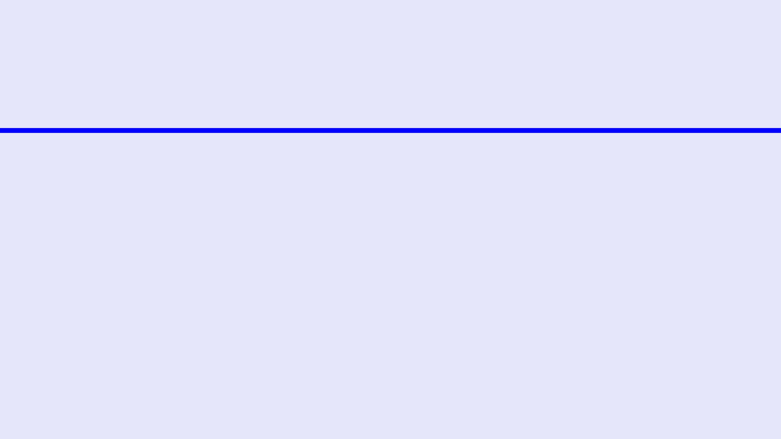
LINKEDIN STRATEGY: PROFESSIONAL BRANDING
FOUNDER BRANDING
PROFESSIONAL STORYTELLING
CAREER-FOCUSED CONTENT
The LinkedIn strategy centers on establishing the founder as a thought leader in the productivity and AI space. By sharing transparent insights into the startup journey, challenges faced, and the long-term vision for Wrindha OS, we build trust and authenticity. This "building in public" approach resonates with the professional community, fostering a deeper connection with the brand beyond its features.
We will utilize professional storytelling to highlight how Wrindha OS solves real-world productivity challenges for high-performing individuals and teams. Content will focus on case studies, success stories, and the practical application of AI in professional workflows. This positions Wrindha OS not just as a tool, but as an essential partner in achieving professional excellence and operational efficiency.
Content will be tailored to address the professional development needs of our audience, offering tips on career planning, skill enhancement, and leveraging AI for competitive advantage. By providing high-value articles and insights on the future of work, Wrindha OS will attract a dedicated following of ambitious professionals who view the platform as a catalyst for their long-term career growth.

Slide 12

X (TWITTER) STRATEGY
THREADS & INSIGHTS
THOUGHT LEADERSHIP
COMMUNITY ENGAGEMENT
X serves as the primary platform for rapid information dissemination and deep-dive intellectual threads. Wrindha OS will utilize threads to break down complex productivity frameworks, AI ethics, and new study methodologies into digestible, viral-ready segments. By sharing research-backed insights and data-driven trends, we aim to capture the attention of high-intent users who value structured, long-form text content in a real-time environment.
Our strategy focuses on positioning the Wrindha OS brand and its founders as authoritative voices in the EdTech and AI sectors. We will actively participate in industry discussions using relevant hashtags like #Productivity and #AI, sharing bold opinions on the future of personal growth. This proactive engagement is designed to build trust and credibility among technology enthusiasts and professional peers, driving brand recognition and influence.
Real-time interaction is the cornerstone of our X presence. We will host regular Twitter Spaces for live Q&A sessions with the team and industry experts, fostering a sense of community and transparency. By running flash contests, polls, and responding to trending topics with a unique Wrindha OS perspective, we ensure consistent engagement and high visibility within the platform's fast-moving feed, driving user retention and loyalty.

Slide 13
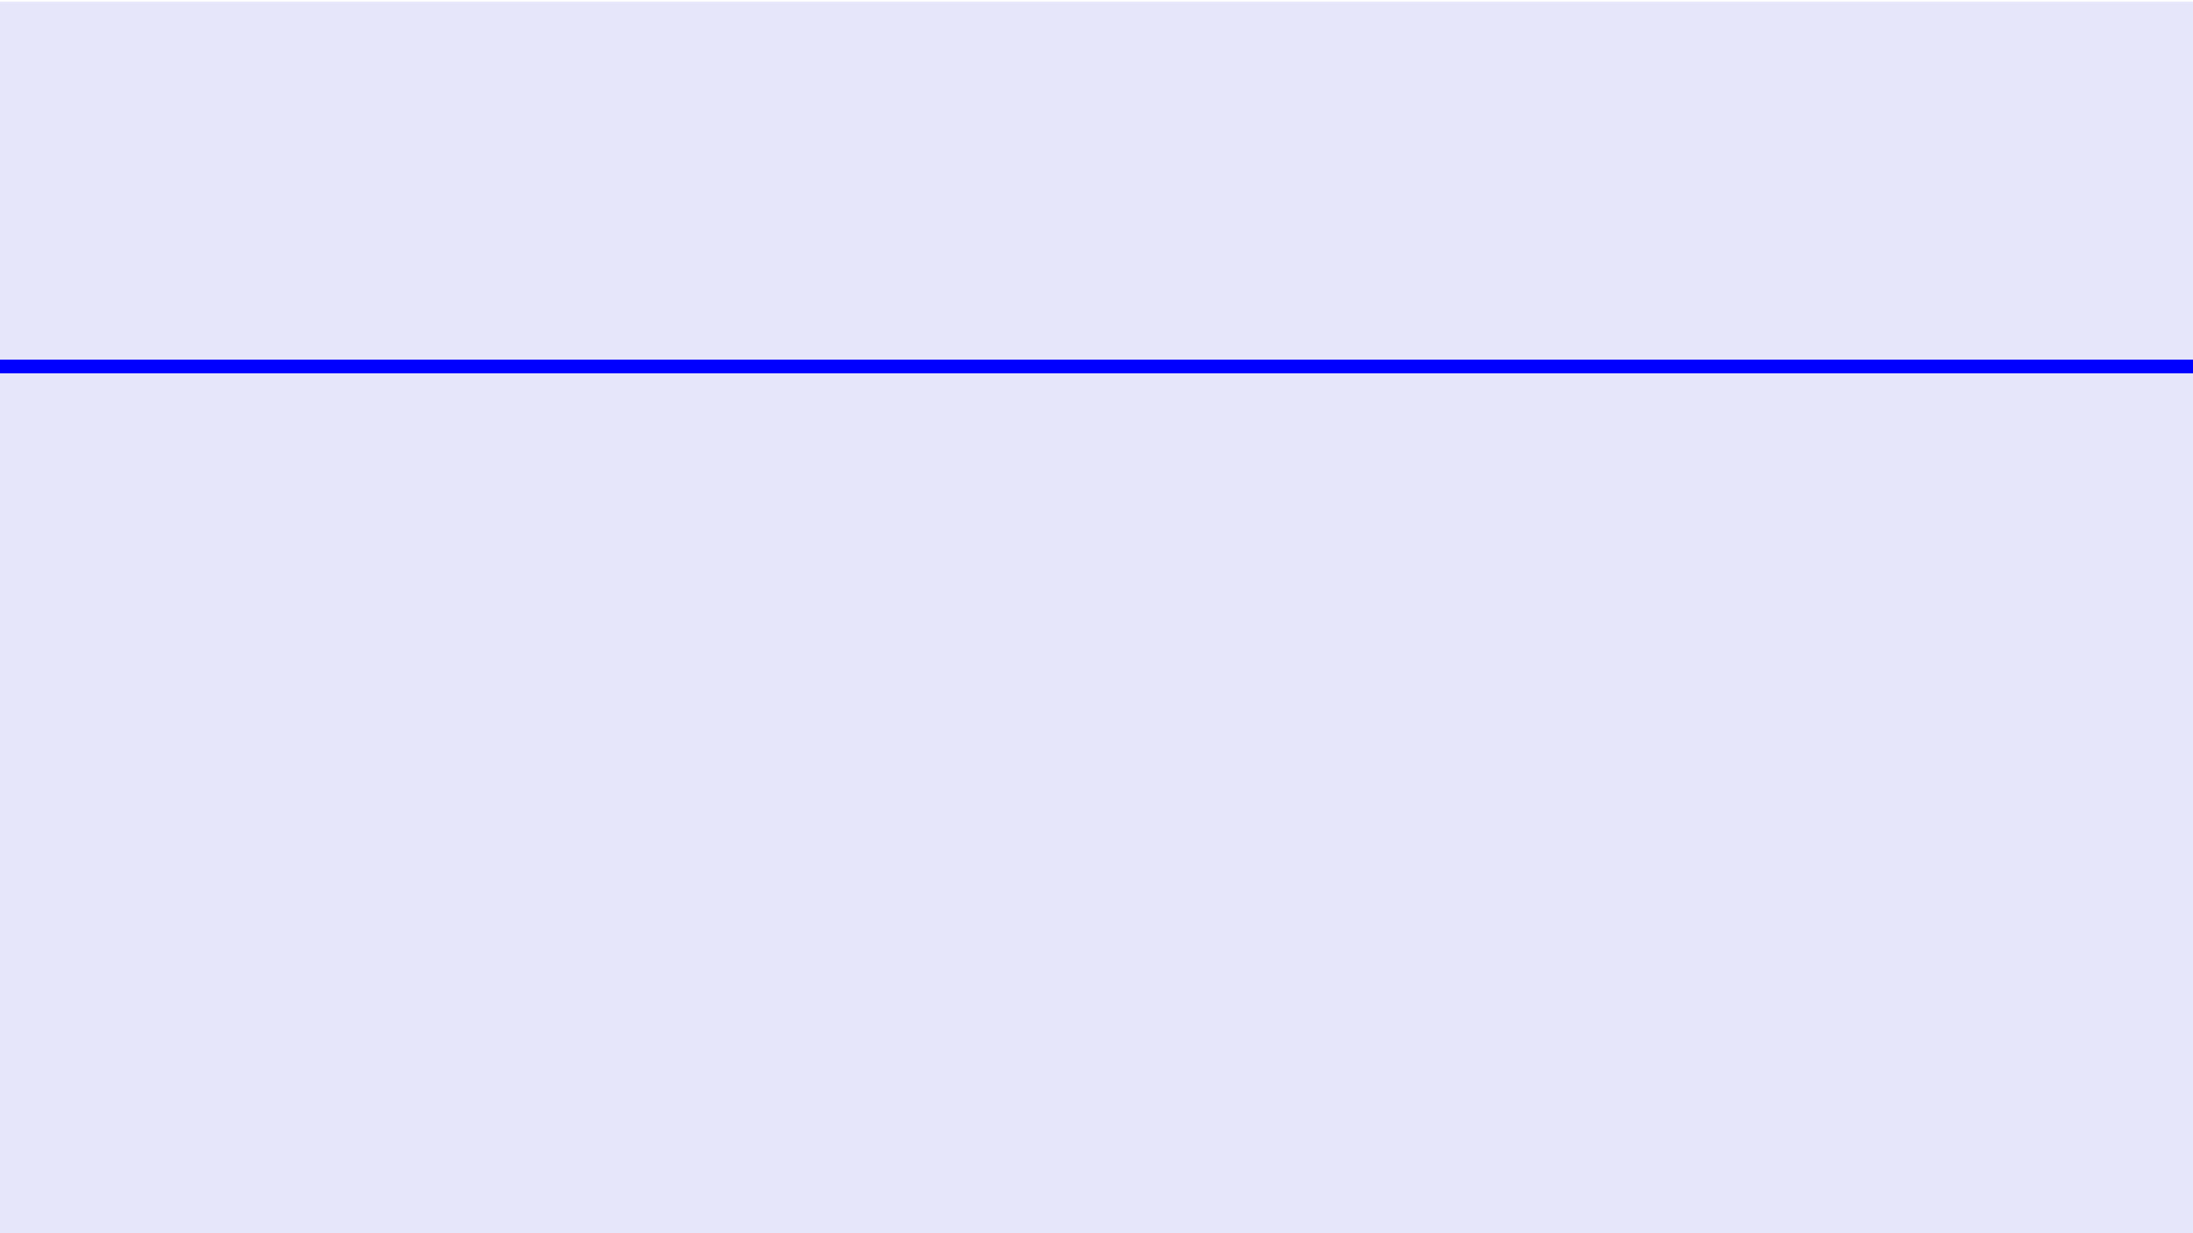
FACEBOOK STRATEGY: COMMUNITY & RETENTION
COMMUNITY GROUPS
EDUCATIONAL CONTENT
RETENTION METHODS
Facebook Groups will serve as the primary hub for peer-to-peer support and deep community engagement. Wrindha OS will establish official user groups categorized by interest, such as "Competitive Exam Aspirants" and " Productivity Enthusiasts." These spaces will encourage user-generated content, success stories, and collaborative problem-solving, fostering a sense of belonging and long-term brand loyalty among our most active users.
Our Facebook page will prioritize longer-form educational videos, webinars, and live Q&A sessions. This content is designed to provide comprehensive value, covering deep dives into Wrindha OS features and broader productivity frameworks. By sharing high-quality resources and sparking discussions through engaging polls and prompts, we aim to position Wrindha OS as an authoritative voice in the personal growth and EdTech space.
To ensure high audience retention, we will implement a consistent posting schedule with diverse content formats tailored to the Facebook algorithm. Prompt responses to comments and messages will build trust and rapport. Additionally, exclusive contests, early access programs, and "Power User" spotlights within our groups will incentivize continued participation and turn casual users into vocal brand advocates.

Slide 14
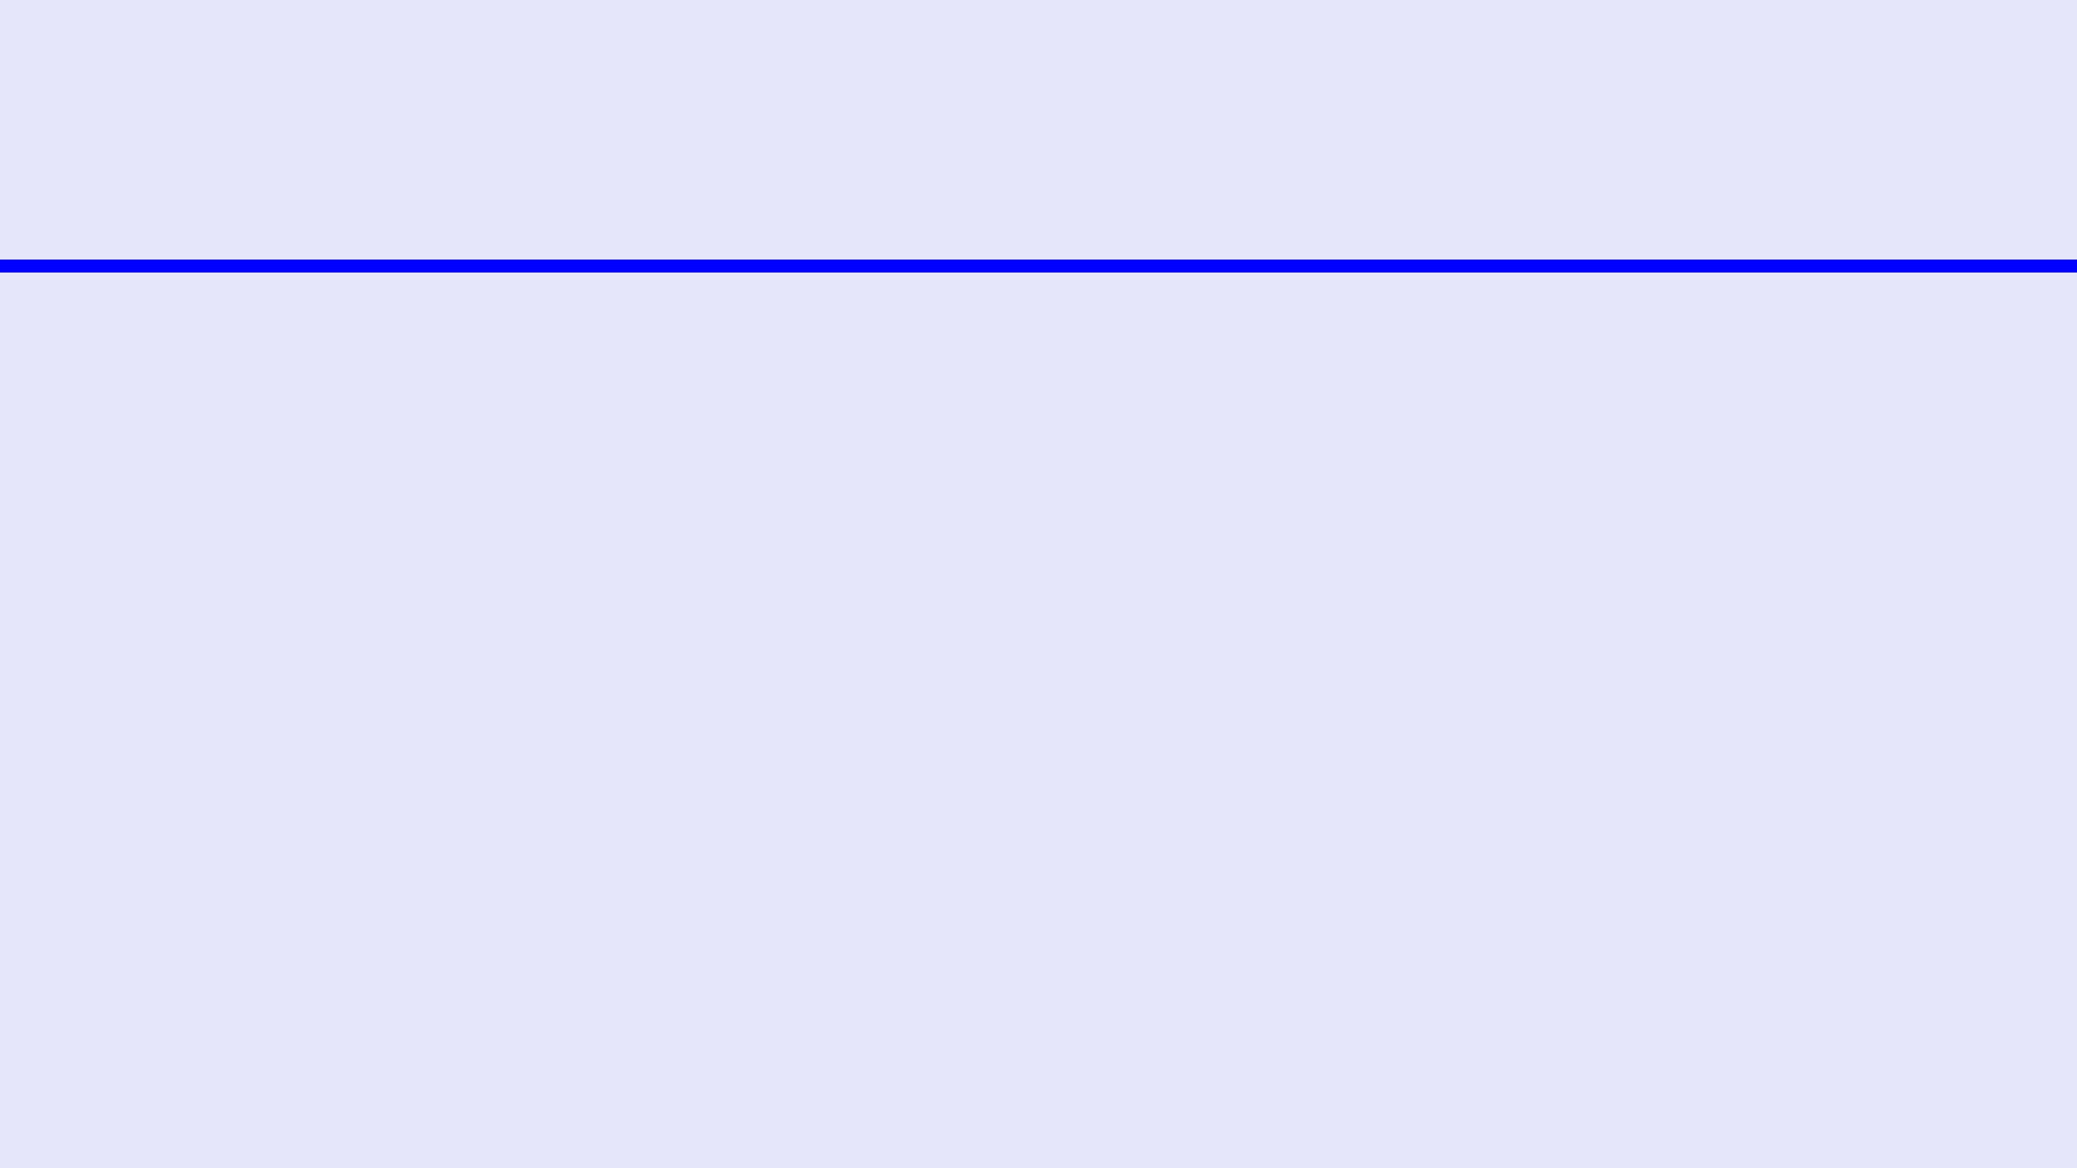
CONTENT OPPORTUNITY ANALYSIS: TOP 50 TOPICS
PRODUCTIVITY
STUDY & LEARNING
AI & TECHNOLOGY
GROWTH & HABITS
Time Blocking Systems
Active Recall Methods
AI Personal Assistants
Atomic Habit Stacking
Pomodoro Technique 2.0
Spaced Repetition AI
AI for Research Ops
Willpower Optimization
Deep Work Strategies
Feynman Technique
AI Writing Partners
Discipline vs Motivation
Digital Minimalism
Interleaving Practice
Automated Scheduling
Goal Setting Systems
Task Management Flow
Mind Mapping Systems
AI Data Visualization
Self-Control Frameworks
Eisenhower Matrix
Note-taking Frameworks
AI in Modern Education
Procrastination Cure
Getting Things Done (GTD)
Exam Prep Psychology
AI Productivity Hacks
Mindfulness for Focus
Flow State Induction
Learning Style Myths
Ethics of AI Usage
Emotional Intelligence
Batching Workflows
Memory Palace Tech
Future of AI Agents
Resilience Building
Single-tasking Mastery
Speed Reading Skills
Prompt Engineering
Growth Mindset Shift
Energy Management
Academic Focus Tools
AI-Powered Habit Bots
Stress Management
Morning Routine Design
Collaborative Learning
Digital Second Brain
Critical Thinking Ops

Slide 15
COMPETITOR INSIGHTS: BRANDS & INFLUENCERS
SUCCESSFUL BRANDS
KEY INFLUENCERS
STRATEGIC TAKEAWAYS
Notion dominates the market through community-led growth and a versatile "all-in-one" workspace positioning. Their content strategy focuses heavily on user-generated templates and community showcases. ClickUp targets high-productivity teams with feature-rich messaging and advanced integrations, while Todoist maintains a strong hold on individuals through simplicity and gamified habit building. These brands set the benchmark for functional excellence and ecosystem loyalty.
Ali Abdaal and Thomas Frank lead the global productivity niche, focusing on evidence-based study techniques and life organization systems. In the Indian context, Ankur Warikoo has built a massive following by blending career advice with personal growth and entrepreneurship. These influencers demonstrate the power of educational content and personal branding in driving adoption for productivity tools, serving as critical blueprints for Wrindha OS's outreach.
The primary lesson from successful competitors is the necessity of community-led growth and transparent "building in public" narratives. Educational content that provides immediate value—such as in-depth guides and templates—is the most effective driver of user acquisition. Wrindha OS must leverage these insights by fostering a strong user community and positioning its AI capabilities as a unique value proposition that transcends traditional task management.

Slide 16
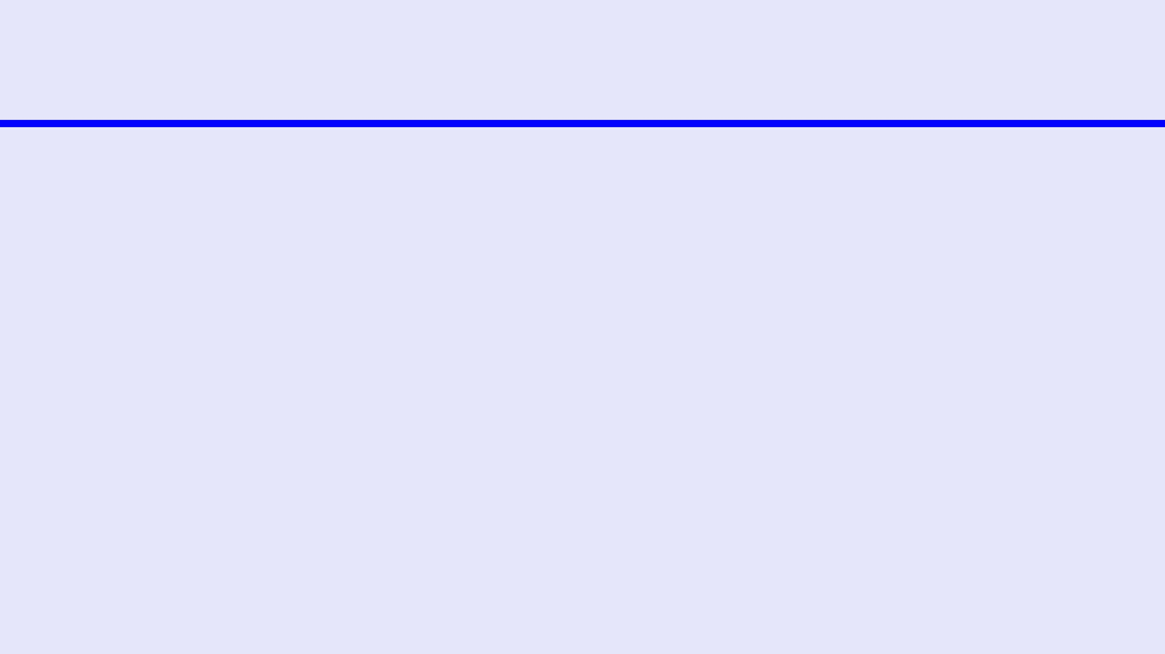
CONTENT PILLARS: THE WRINDHA OS FRAMEWORK
1. STUDY SYSTEMS
2. PRODUCTIVITY
3. HABITS & DISCIPLINE
4. AI & TECHNOLOGY
Evidence-based learning strategies including Active recall and Spaced Repetition masterclasses.
Frameworks for Deep Work, Time Blocking, and Eisenhower Matrix implementation.
Sustainable routine building, habit stacking, and willpower optimization techniques.
Leveraging AI assistants and automation for enhanced cognitive performance.
TARGET: PROFESSIONALS | FORMAT: LI/YT
TARGET: ALL | FORMAT: REELS/SHORTS
TARGET: TECHIES | FORMAT: X/YT
TARGET: STUDENTS | FORMAT: YT/IG
5. CAREER GROWTH
6. FOUNDER JOURNEY
7. COMMUNITY SUCCESS
8. LIFE MANAGEMENT
Skill development, networking strategies, and professional branding for the modern era.
Transparent "Building in Public" insights, startup challenges, and the vision for Wrindha OS.
User spotlights and testimonials showcasing real-world transformations using the OS.
Holistic systems for digital minimalism, Second Brain, and life organization.
TARGET: PROFESSIONALS | FORMAT: LI
TARGET: ALL | FORMAT: IG/FB
TARGET: LEARNERS | FORMAT: BLOG/YT
TARGET: ALL | FORMAT: LI/IG

Slide 17

90-DAY CONTENT ROADMAP
MONTH 1
MONTH 2
MONTH 3
FOUNDATION & AWARENESS
ENGAGEMENT & ADOPTION
RETENTION & EXPANSION
The initial phase focuses on establishing brand presence and educating the audience on core study systems. We will launch the "Unlock Your Potential" campaign, prioritizing YouTube tutorials and Instagram Reels. Key content includes deep dives into Active Recall and study planning. Success will be measured by a 20% growth in Instagram followers and initial brand sentiment analysis.
Phase two shifts focus to productivity frameworks and habit building. The "Master Your Day" theme will dominate LinkedIn and Facebook Groups, featuring professional success stories and Deep Work strategies. We will initiate influencer partnerships and host live Q&A sessions to drive product adoption. The primary KPI is a 15% increase in LinkedIn engagement and a 5% lift in product sign-ups.
The final phase emphasizes career development and life management systems. We will launch the "Wrindha OS Power User" program to foster long-term retention. Content will focus on digital minimalism and goal tracking, delivered through long-form blog posts and email nurturing. Objectives include a 10% increase in active users and a 5% growth in premium subscriptions through retargeting.

Slide 18
STRATEGIC IMPERATIVES
VIDEO-FIRST CONTENT
Wrindha OS CENTRIC MESSAGING
COMMUNITY-LED GROWTH
Prioritize short-form video across Reels, YouTube Shorts, and TikTok to capture the dominant 58% of social media consumption time. Content must be bite-sized, actionable, and optimized for platform-specific algorithms to drive organic discovery. Long-form YouTube content should serve as the authoritative foundation for deep-dive educational value and search-based traffic acquisition.
Position Wrindha OS's capabilities as the core differentiator. Messaging should move beyond feature lists to demonstrate how it acts as a proactive thinking partner for study, work, and life organization. Highlighting driven focus tools and intelligent scheduling will resonate with the 481 million Indian users actively seeking advanced technology to solve productivity bottlenecks.
Foster robust user communities on Facebook and Instagram to drive loyalty and user-generated content. By implementing a "building in public" approach and showcasing real user success stories, Wrindha OS can create a self-sustaining ecosystem of advocates. This strategy leverages social proof and peer-to-peer support to reduce acquisition costs and increase long-term user retention.

Slide 19
SUCCESS METRICS & ROI
AWARENESS METRICS
ENGAGEMENT KPIS
CONVERSION & ROI
We will track top-of-funnel growth through reach and impression data across Instagram Reels and YouTube Shorts. Key indicators include a 25% month-over-month increase in organic reach and a consistent growth in brand search volume. These metrics will validate the effectiveness of our video-first strategy in capturing the attention of the 5.66 billion global social media users.
Engagement will be measured by save rates on Instagram Carousels, average view duration on YouTube long-form content, and interaction rates in Facebook Groups. We aim for a 5% engagement rate on LinkedIn and a 10% increase in community-led discussions. High engagement signifies that our content pillars are resonating with the core audience segments and building brand authority.
The ultimate measure of success is the conversion of social media followers into active Wrindha OS users. We will monitor click-through rates (CTR) from social profiles to the landing page and track sign-up attribution. Our goal is a 3% conversion rate from social traffic and a 15% increase in premium user retention, ensuring a positive return on investment for our marketing efforts.

Slide 20
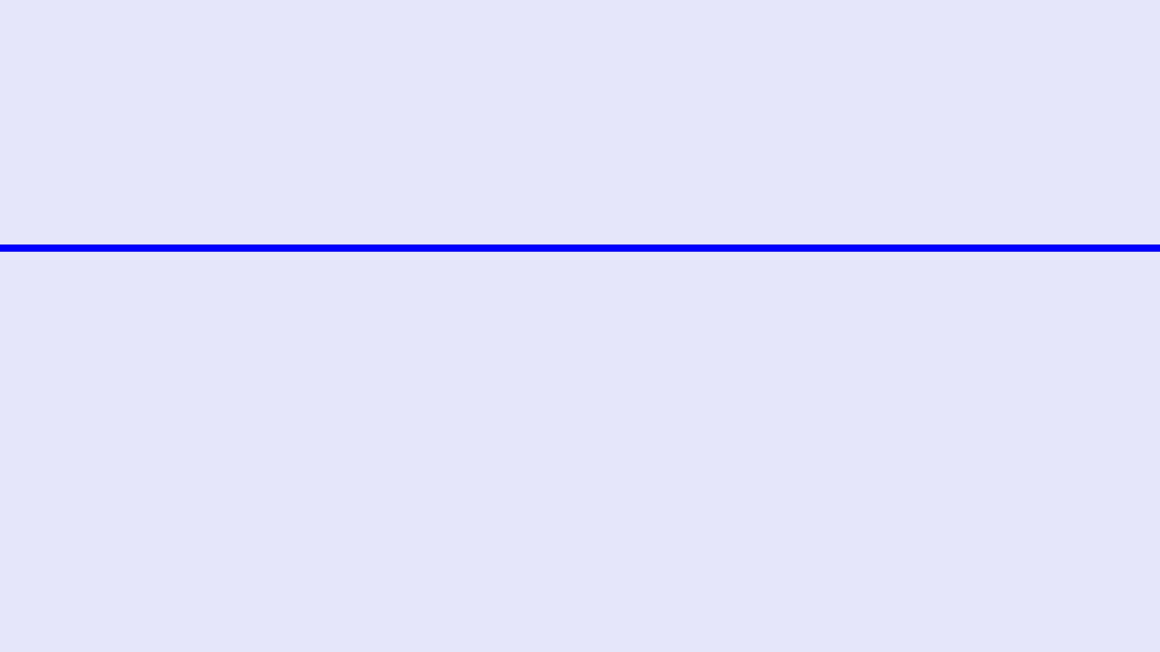
EMPOWERING A PRODUCTIVE FUTURE
Wrindha OS is more than just a productivity tool; it is a catalyst for personal transformation. By unifying fragmented digital lives and we empower individuals to achieve their highest potential. Our vision is to create a world where technology serves as a proactive partner in human growth, fostering a future of clarity, focus, and unparalleled achievement.
JOIN US IN REDEFINING THE FUTURE OF PERSONAL OPERATING SYSTEMS.

